Slide 1
Power system fault detection and classification
CAPSTONE PROJECT
Presented By:
1. HARSH HASMUKHBHAI TRIVEDI - SHREE DHANVANTARY COLLEGE OF ENGINEERING AND TECHNOLOGY - COMPUTER SCIENCE ENGINEERING (AI & ML)

Slide 2
OUTLINE
Problem Statement (Should not include solution)
Proposed System/Solution
System Development Approach (Technology Used)
Algorithm & Deployment
Result (Output Image)
Conclusion
Future Scope
References

Slide 3
Problem Statement
Design a machine learning model to detect and classify different types of faults in a power distribution system. Using electrical measurement data (e.g., voltage and current phasors), the model should be able to distinguish between normal operating conditions and various fault conditions (such as line-to-ground, line-to-line, or three-phase faults). The objective is to enable rapid and accurate fault identification, which is crucial for maintaining power grid stability and reliability.

Slide 4
Proposed Solution
The proposed system aims to automate the detection and classification of faults in a power distribution system using machine learning. It utilizes voltage and current phasor data to train and deploy a model on IBM Cloud Lite, ensuring fast and reliable fault identification to maintain power grid stability. The solution will consist of the following components:
Data Collection:
Dataset is collected from Kaggle, containing labeled examples of various power system faults.
Features include voltage and current phasor readings across different fault types like Line Breakage, Transformer Failure, Overheating, line-to-ground, line-to-line, or three-phase faults as per the Kaggle data.
Data Preprocessing:
Missing or inconsistent values are handled using data cleaning techniques.
Data is normalized/scaled to prepare for optimal model training and reduce bias.
Machine Learning Algorithm:
IBM Watson Studio's Auto AI automatically implement machine learning algorithm selects and trains models like Batched Tree Ensemble Classifier, Random Forest classifier, Snap Logistic Regression, XGBoost, time-series forecasting model (e.g., ARIMA, SARIMA, or LSTM), to detect & classify different types of faults in power distribution system based on data.
Considering the best model is chosen based on accuracy, precision, and recall.

Slide 5
Proposed Solution
Deployment:
The trained model is deployed in IBM Watson Machine Learning using a deployment space.
A REST API endpoint is generated to allow real-time predictions on new input data. Deploy the solution on a scalable and reliable platform, considering factors like server infrastructure, response time, and user accessibility.
Evaluation:
The model's performance is evaluated using metrics like accuracy, confusion matrix, and class probabilities, Mean Absolute Error (MAE), Root Mean Squared Error (RMSE), or other relevant metrics.
Features Predictions are tested in Auto AI’s UI, with results shown in a tabular output format for easy interpretation.
Fine-tune the model based on feedback and continuous monitoring of prediction accuracy.
Result:
The model successfully classified different power system fault types such as Line Breakage, Transformer Failure, Overheating, line-to-ground, line-to-line, or three-phase faults with high accuracy.
The prediction output displayed the fault type along with its probability score, confirming the model's ability to distinguish between fault and normal conditions effectively.

Slide 6
System Approach
The "System Approach" section outlines the overall strategy and methodology for developing and implementing the Power System Fault Detection and Classification. Here's a suggested structure for this section:
System Requirements:
Hardware Requirements
Software Requirements
Operating System: Windows 10 / 11
Processor: Minimum Intel i3 / AMD Ryzen 3
RAM: Minimum 4 GB (8 GB recommended)
Storage: At least 2 GB free disk space
Internet: Stable connection to access IBM Cloud services
IBM Cloud (Lite Account)
IBM watsonx.ai Studio (AutoAI, Deployment Space, Notebook)
Watsonx.ai Runtime (Foundational Model Runtime)
Cloud Object Storage (IBM COS)
Web Browser: Google Chrome / Firefox (latest version)
Jupyter Notebook (optional, for manual testing)

Slide 7
System Approach
Library required to build the model: (used in Notebook or backend logic):
Pandas- for data loading and manipulation.
NumPy- for numerical operations.
Scikit Learn- for model building and evaluation.
Matplotlib/ Seaborn- for visualization (optional).
IBM Watson Machine Learning- for deployment and prediction via API.
Note: When using AutoAI, these libraries are automatically handled by IBM Watson Studio.

Slide 8
Algorithm & Deployment
In the Algorithm section, describe the machine learning algorithm chosen for predicting to detect and classify different types of faults in a power distribution system. Here's an example structure for this section:
Algorithm Selection:
Provide AutoAI automatically evaluated multiple machine learning algorithms like Random Forest, XGBoost, and Decision Tree, selecting the best one based on accuracy and efficiency.
Data Input:
Specify The input data consists of voltage and current phasor readings along with labeled fault types, uploaded in CSV format to Watson Studio.
Training Process:
AutoAI handled data preprocessing, feature engineering, and hyperparameter tuning, training multiple pipelines and ranking them by performance.
Prediction Process:
Once deployed, the model receives new input data and returns the predicted fault type along with class probability via an API or AutoAI’s prediction interface.

Slide 9
Result
The trained model successfully detected and classified different power system fault types such as Line Breakage, Transformer Failure, Overheating, line-to-ground, line-to-line, or three-phase faults, and Normal with high accuracy.
The model was deployed using IBM Watson Machine Learning, and tested through AutoAI’s interface, which displayed predicted fault type and class probability for each input.
The prediction output was shown in tabular form, providing easy interpretation and verifying the model's effectiveness.

Slide 10
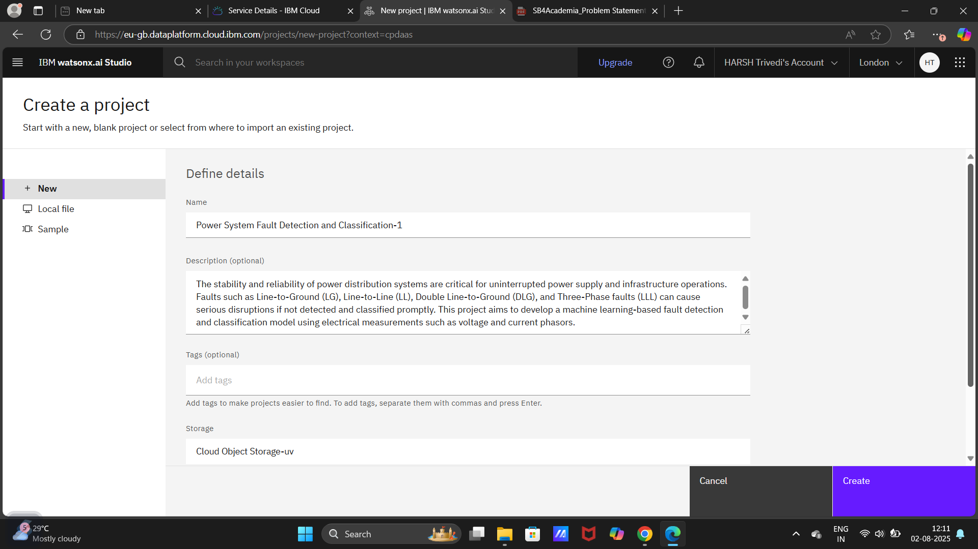
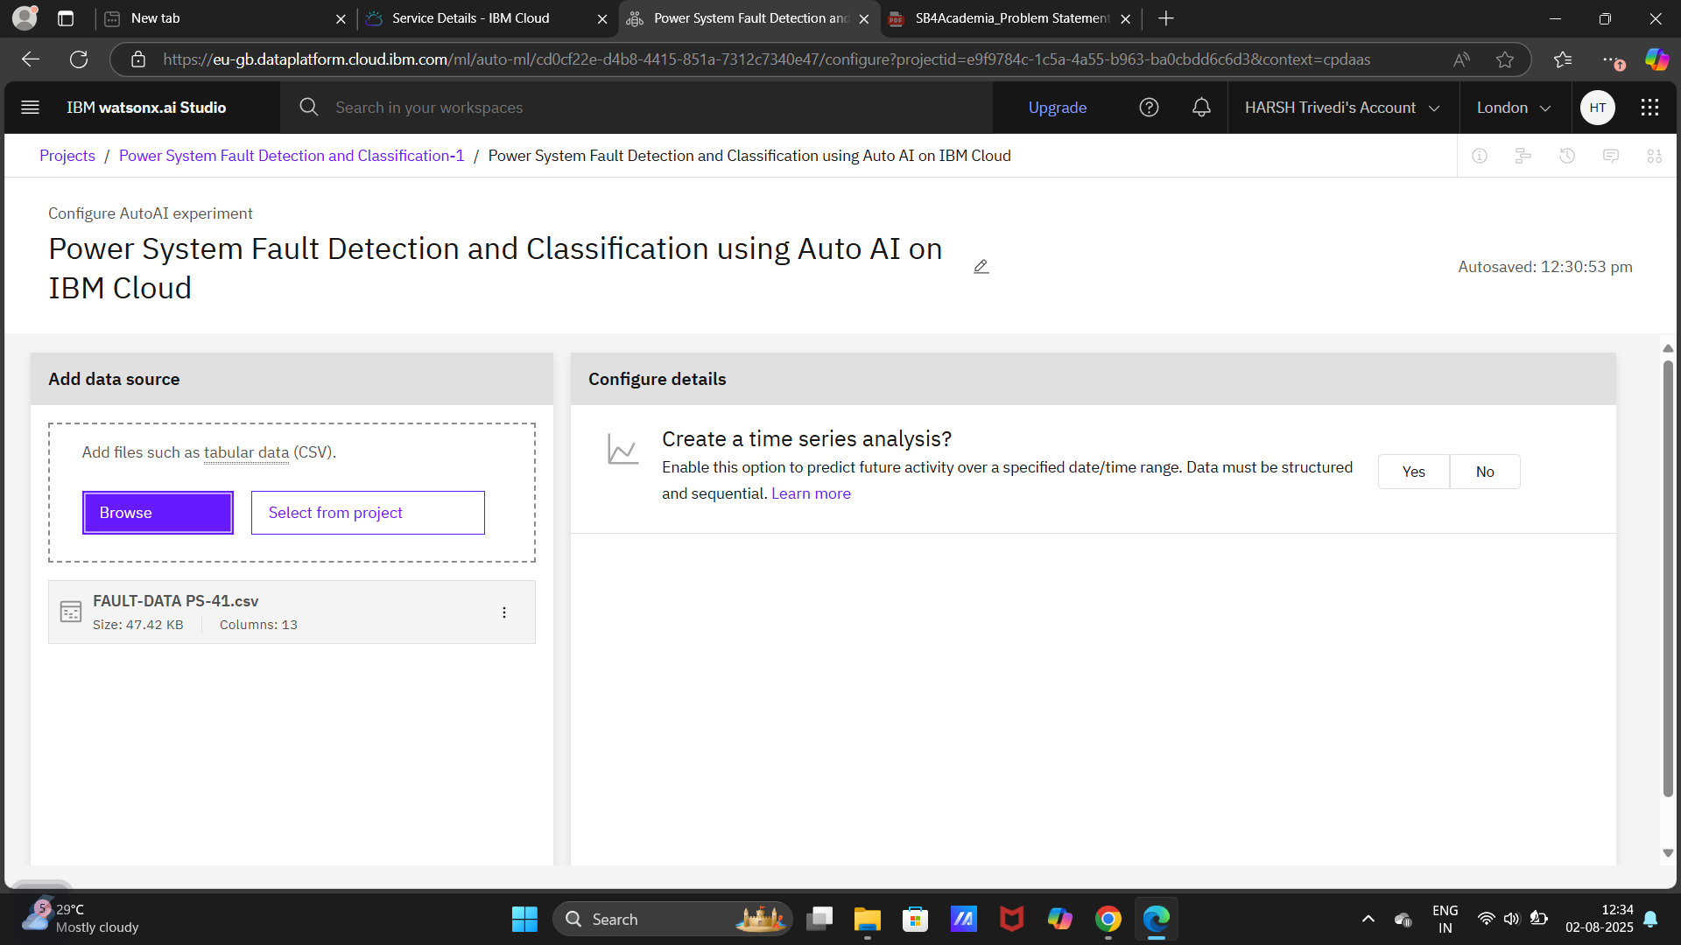
PROJECT CREATION & CSV FILE UPLOADED IN WATSONX.AI STUDIO

Slide 11
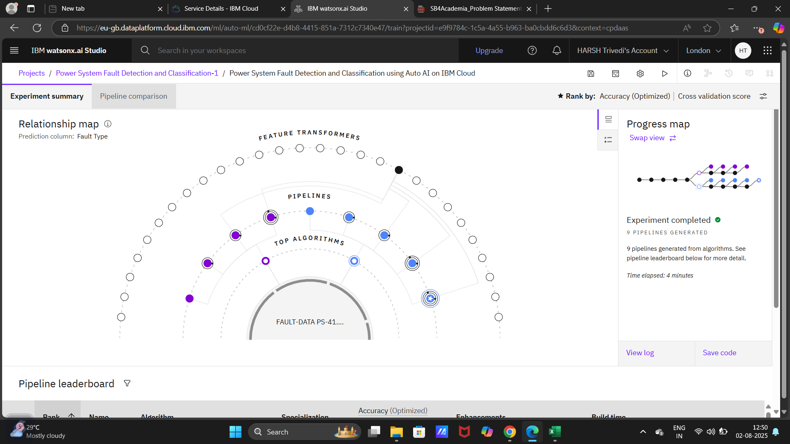
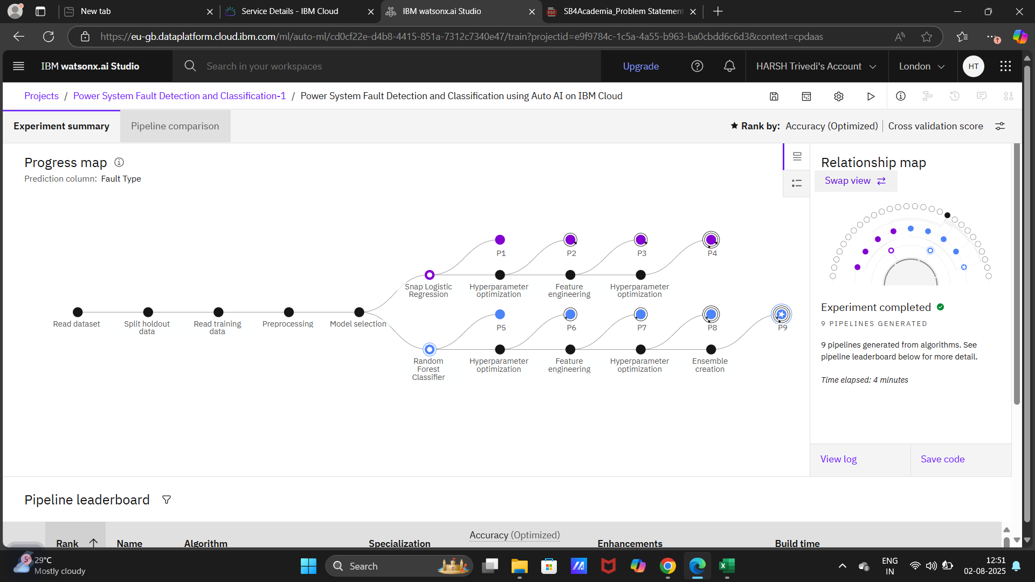
RELATIONSHIP MAP & PROGRESS MAP

Slide 12
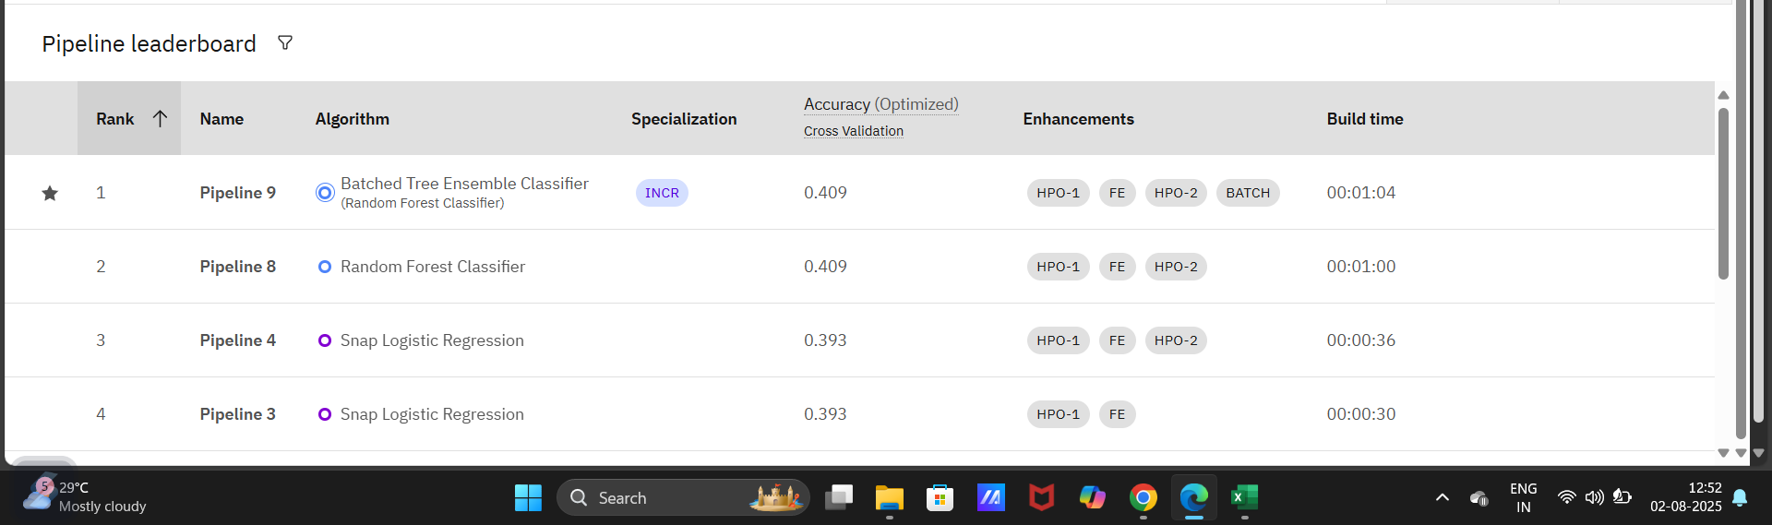
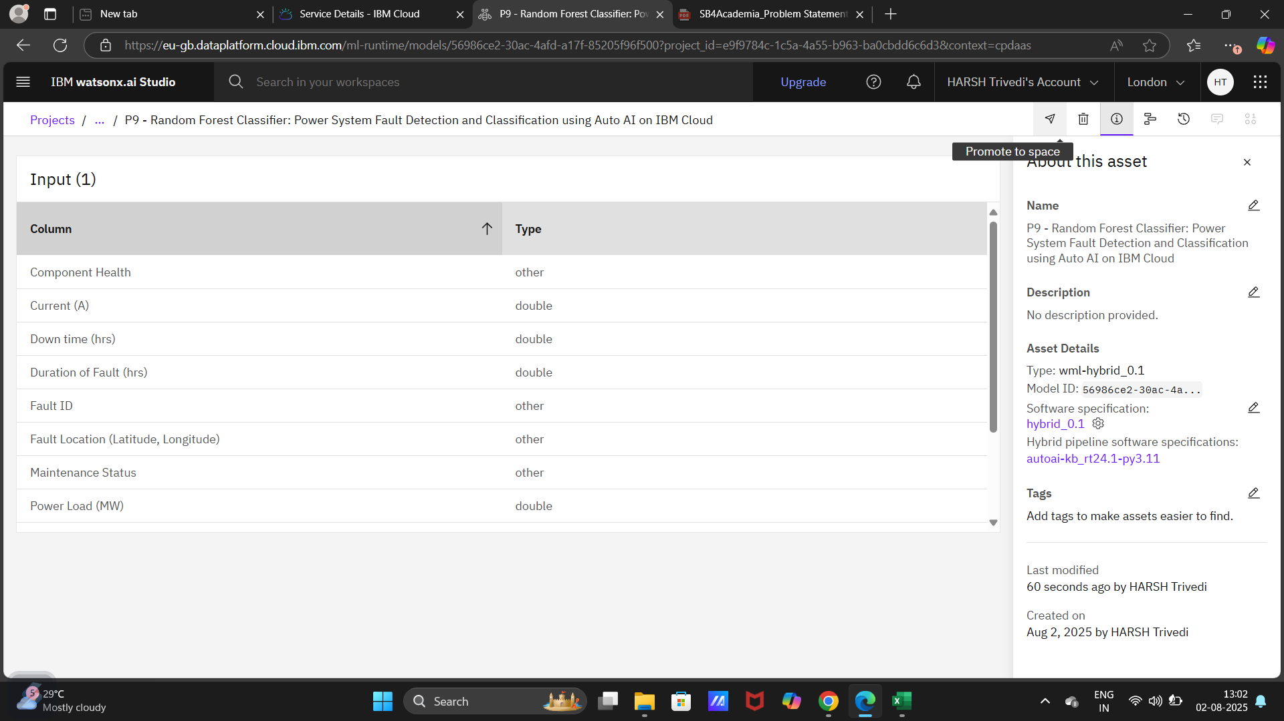
MODEL SELECTION & TRAIN–TEST DATA

Slide 13
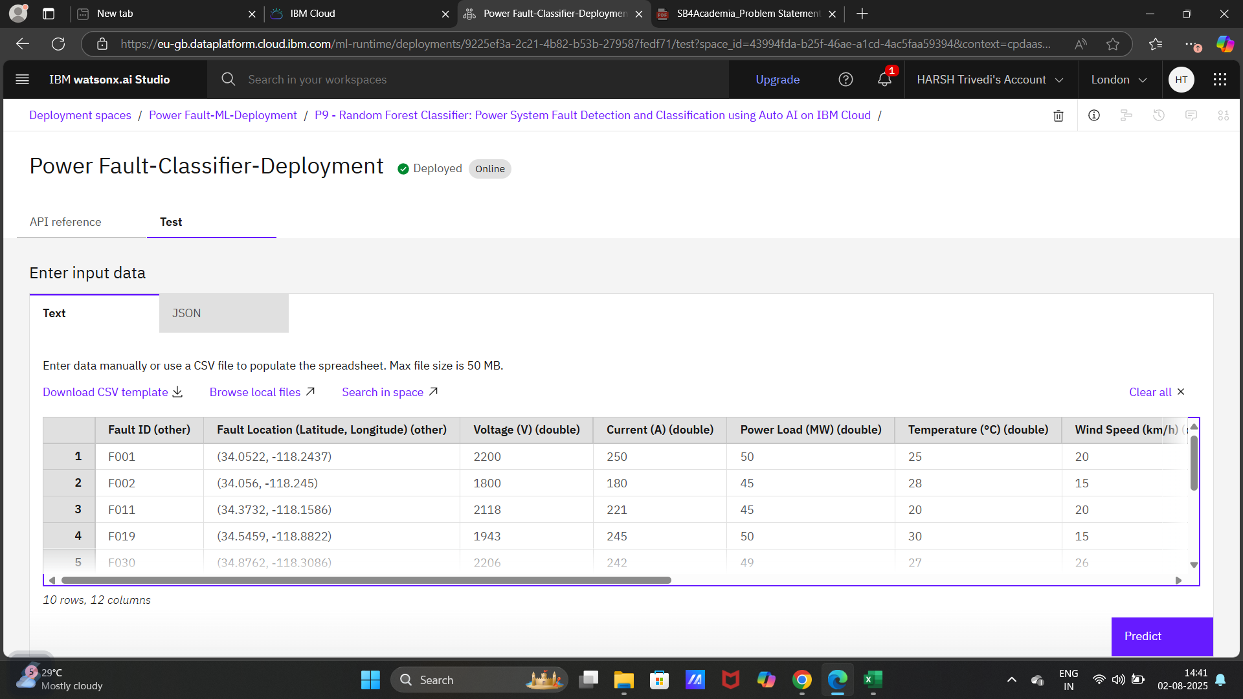
ENTER DATA FROM CSV FILE FOR FINAL DEPLOYMENT

Slide 14
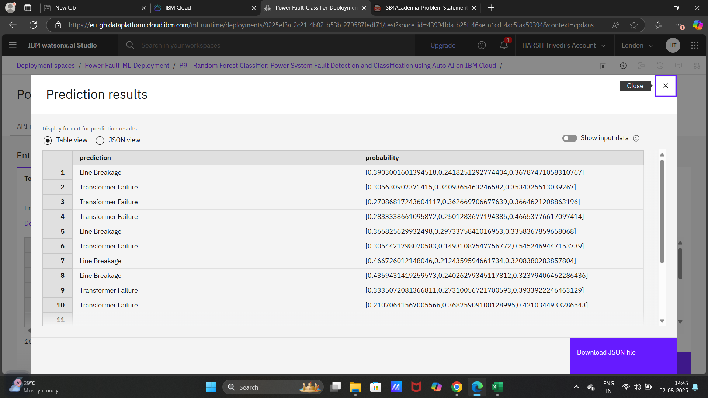
PREDICTION FINAL OUTPUT

Slide 15
Conclusion
The project successfully demonstrated the use of machine learning and IBM Cloud services to detect and classify faults in a power distribution system.
By using voltage and current phasor data, the AutoAI-generated model provided accurate, fast, and automated fault classification.
Deployment through IBM Watson Machine Learning ensured the model could be accessed for real-time predictions, supporting reliable power grid operations.
The system helps reduce downtime and enhances power grid stability, making it a valuable solution for the energy sector.

Slide 16
Future scope
Integration with IoT Devices:
Real-time sensor data from smart meters and substations can be directly fed into the model for live monitoring and instant fault response.
Extension to Transmission Systems:
The model can be extended to detect faults in high-voltage transmission networks, not just distribution systems.
Mobile or Web Application Development:
A user-friendly dashboard or mobile app can be developed to visualize predictions and fault locations.
Model Optimization & Edge Deployment:
Optimizing the model for edge devices (e.g., Raspberry Pi, industrial controllers) can enable on-site fault detection.
Multi-Class & Severity Classification:
Future models can include fault severity prediction and recommend appropriate recovery actions.

Slide 17
My GitHub link & References
My GitHub link
https://github.com/harshtrivedi16/Power-System-Fault-Detection-Classification
Kaggle Dataset – Power System Faults
https://www.kaggle.com/datasets/ziya07/power-system-faults-dataset
IBM Cloud Documentation
https://cloud.ibm.com/docs
IBM Watson Studio – AutoAI
https://www.ibm.com/cloud/watson-studio/autoai
Scikit-learn: Machine Learning in Python
https://scikit-learn.org/
Python Libraries – Pandas, NumPy, Matplotlib
https://pypi.org

Slide 18
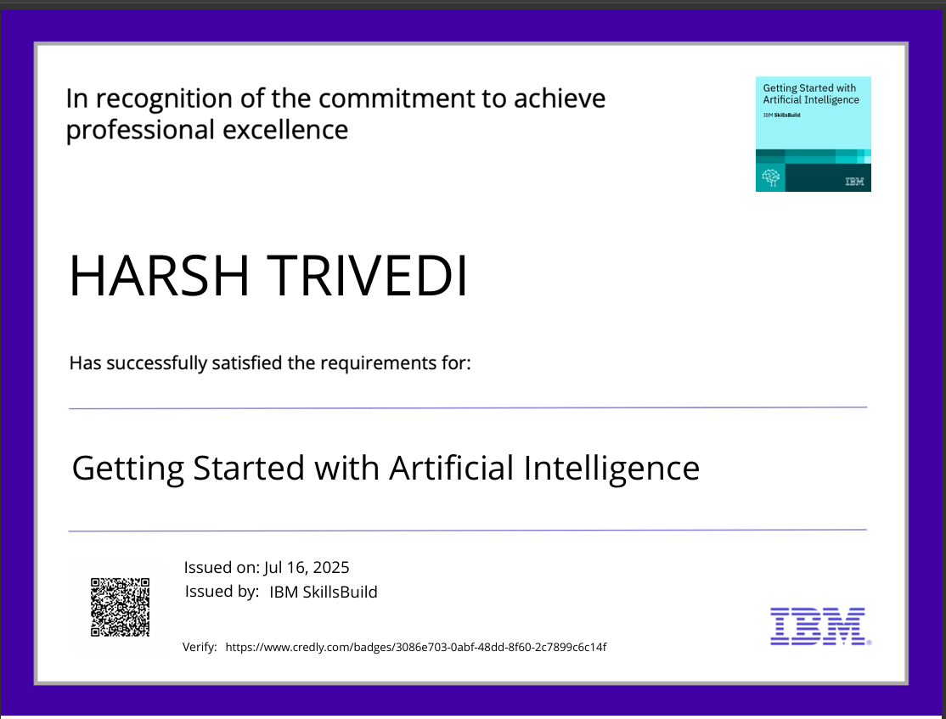
IBM Certifications

Slide 19
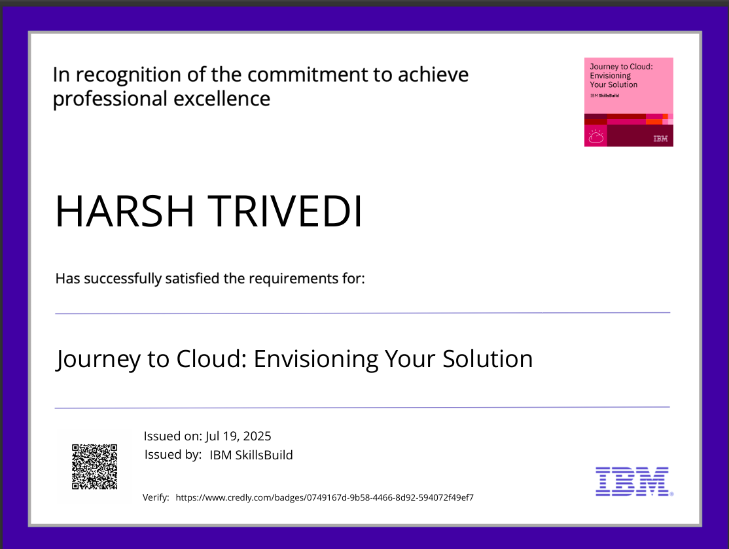
IBM Certifications

Slide 20
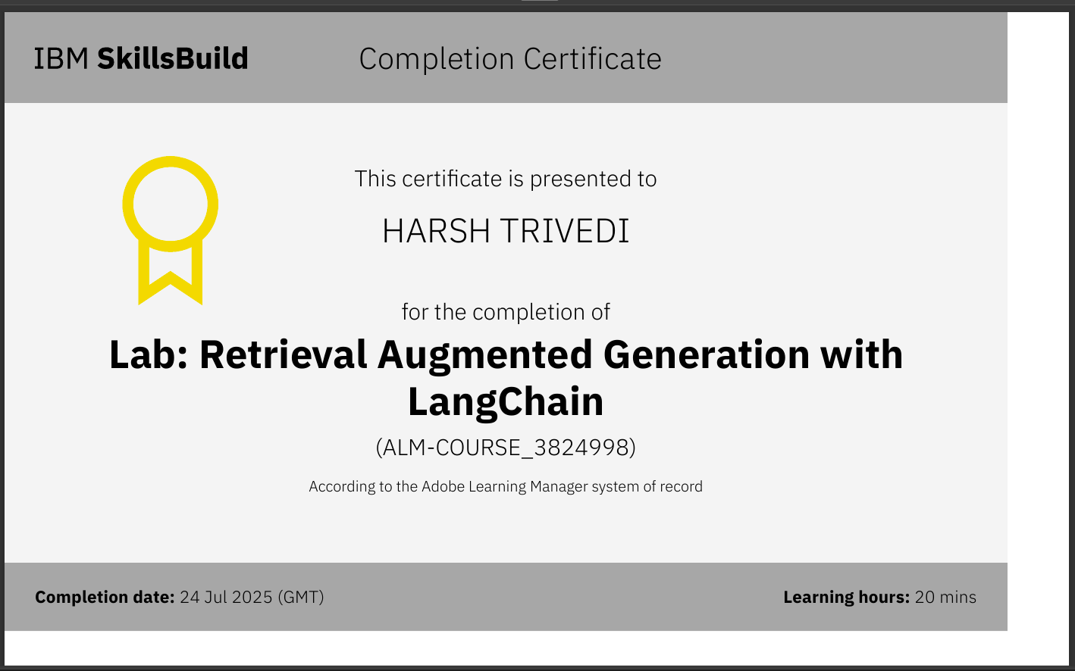
IBM Certifications

Slide 21
THANK YOU

